Slide 1
‘VEGETES’
GROUP1
NCAT CEP 2014
Department of Management Studies
IIT Delhi
30th June – 4th July, 2014

Slide 2
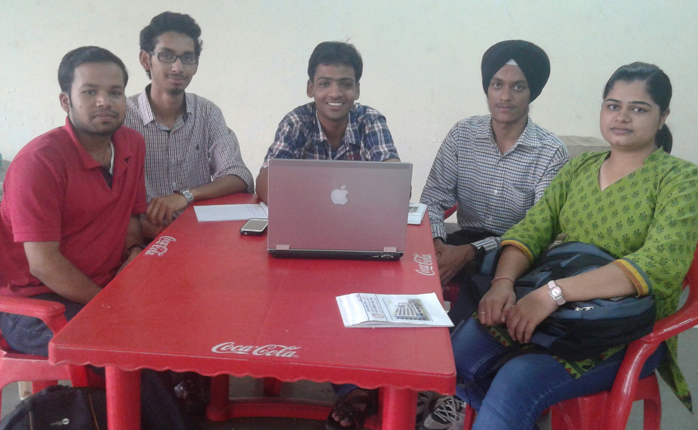
The VegeteS :
Divyanshu Gupta
Prateek Maheshwari
Raminder Singh
Ricky R Goyal
Jyoti Saroha

Slide 3
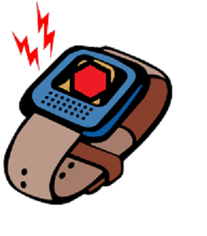
Top 3 ideas
Vibrating wrist watch.
Phone profile changer.
Mechanical washing machine.

Slide 4
Executive summary
PROJECT: To identify a day-to-day life problem, and finding a creative solution ( JUGAAD) to the problem.
PAIN AREA: Creating an alternative alarm for those who cannot hear normal alarm or when in deep sleep.
THE PRODUCT: A wrist watch with a vibrator, such that each time we set an alarm, the watch vibrates instead of creating sound, which to an extent will help the person regain consciousness, which normal sound alarms do not.
DECISION MAKING TOOLS USED: Fish-Bone Analysis, The Six Thinking Hats
PRICE: (Needs to be worked on) But the ranges can be for Top-end and Mid-Range watches (Technology will be based on the target audience i.e. will be flexible)
COMPETITION: CASIO vibration watches, MOM/WIFE waking the person

Slide 5
THE PROBLEM STATEMENT
WHO
WHAT
WHY
needs
because
The people with hearing impairment, students, work people , etc. needs an alternate device to wake up on time because the conventional ways are not helping enough.

Slide 6
MECHANISM
The watch contains a vibrating mechanism, two pin holes and a needle besides all other functions available in conventional analog wrist watches .
Initially we set the alarm timing in the watch and the needle is inserted in the first pin hole, as soon as the watch strikes the set time the watch starts vibrating .

Slide 7
Since the concerned person wears this watch in a hand while sleeping , it makes the person half conscious.
The vibration can only be turned off only when the needle inserted in first pin hole is removed and inserted into the 2nd pin hole.
As the pin hole is of very small diameter ,this insertion process can only be accomplished when the lights are turned on.
So finally the person becomes fully conscious and wakes up .

Slide 8
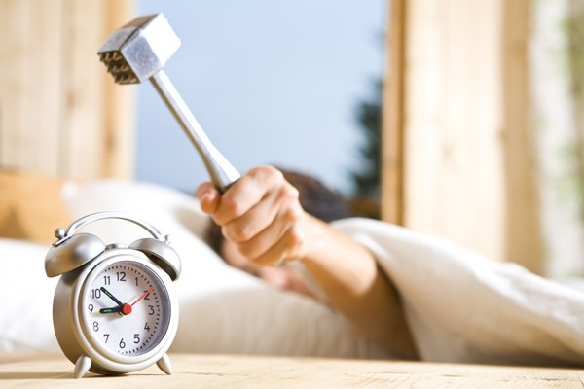
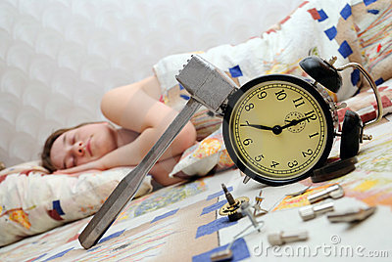
THE PAIN AREA
The lazy people first struggle to switch the alarm off and then sleep.
The alarm’s sound disturbs the other roommates’ sleep.
People with Hearing Impairment don’t hear the alarm.

Slide 9
Fish-bone analysis
PEOPLE
Laziness
Tiredness
MACHINE
Alarm did not sound
Alarm sound not loud enough
Alarm not heard
ENVIRONMENT
Too cozy
Travelling in train
MEASUREMENT
Time not set correctly
Battery drain out

Slide 10



THE 6 THINKKING HATS
WHITE HAT
Majority of the population faces this problem.
Late night sleeping habit makes this problem worse.
YELLOW HAT
Will help us get fully awake.
Will not create any irritating sounds or beeps.
Could not be snoozed or stopped before being fully conscious.
GREEN HAT
Mom
Conventional alarm clocks.
Vibrating wrist watch.

Slide 11



RED HAT
Will help people be punctual.
Other people do not get disturbed.
BLACK HAT
Alternatives are available.
It may be difficult to wear a watch while sleeping
May cause heath problems.
BLUE HAT
The watch would produce a vibrating effect instead of alarm sound.
The alarm can only be stopped when the key is inserted to break the circuit, which needs the person to fully wake up.

Slide 12
Marketing strategy
IDEA : a device to help people wake up on time.
MARKET : people with hearing impairment, students, work people, etc.
IMPACT : It will revolutionize the lives of people, time management will be easier,
Companies can make a market category as it is the need of majority of population.
COMPETITION : Some similar alternatives are available in the market at varied prices.

Slide 13
TEAM
MEMBER NAME | COLLEGE NAME
Jyoti Saroha | Maharaja Surajmal Institute of Technology, Janakpuri, New Delhi
Divyanshu Gupta | Dayalbagh Education Institute, Agra, Uttar Pradesh
Prateek Maheshwari | B K Birla Institute of Engineering & Technology, Pilani, Rajasthan
Raminder Singh | Chandigarh Engineering College, Mohali, Punjab
Ricky R Goyal | Indira Institute of Management, Pune, Maharashtra

Slide 14

Creativity is craziness which adds some value.
~ Priyank NARAYAN(DMS, IIT-D)

